Slide 1
Credit Risk & Data Quality Analytics Platform
An End-to-End Data Analytics, Risk & Data Quality Solution
Python | SQL | Machine Learning | Power BI | Excel
Leisha Nampally
B.Tech Computer Science Engineering

Slide 2
Business Problem, Objectives & Dataset
Business Problem
Financial institutions need accurate and reliable credit data to assess risk and support data-driven decisions.
Credit data may contain:
Missing or inconsistent values
Data-quality issues
Different default patterns across loan segments
Potential anomalies
Project Objectives
Clean and validate credit data
Analyze loan-default patterns
Perform SQL-based risk analysis
Build ML models for default prediction
Develop interactive Power BI dashboards
Establish a reproducible analytics workflow
Dataset
32,581 loan records | 12 variables | Target: loan_status
Key attributes:
Income • Age • Loan Amount • Interest Rate • Loan Grade • Loan Intent • Loan Burden • Previous Default History
Goal: Transform raw credit data into trusted, actionable risk insights.

Slide 3
Data Preparation, Quality & Analytics Workflow
Data Preparation
Inspected missing values and duplicates
Standardized data types
Validated numerical ranges
Checked categorical consistency
Validated target variable
Identified potential outliers
Created an analysis-ready dataset
Data Quality Framework
Completeness — 25%
Uniqueness — 20%
Validity — 25%
Consistency — 20%
Data Type Quality — 10%
Overall Data Quality Score
100%
Analytics Workflow
Raw CSV→ Python ETL→ Data Quality Validation→ Clean Dataset→ SQL Analysis→ Risk & ML→ Power BI

Slide 4
Risk Analysis & Machine Learning
Machine Learning
Default Prediction Models
Logistic Regression — baseline classification
Random Forest — non-linear classification
Evaluation
Precision
Recall
F1-score
ROC-AUC
Confusion Matrix
Explainability
Random Forest Feature Importance
SHAP
Output:
Predicted default probabilities and model-based risk indicators
Credit Risk Analysis
Calculated overall loan default rate
Analyzed default rates by loan grade
Compared risk across loan purpose and home ownership
Examined income segments and loan burden
Analyzed previous default history
Investigated interest-rate and age-based patterns
Flagged potential anomalies using extreme-value screening
Risk Focus
Loan burden + interest rate + previous default history + borrower characteristics
EDA & Risk Analysis → Feature Preparation → ML Models → Model Evaluation → Explainability → Risk Insights

Slide 5
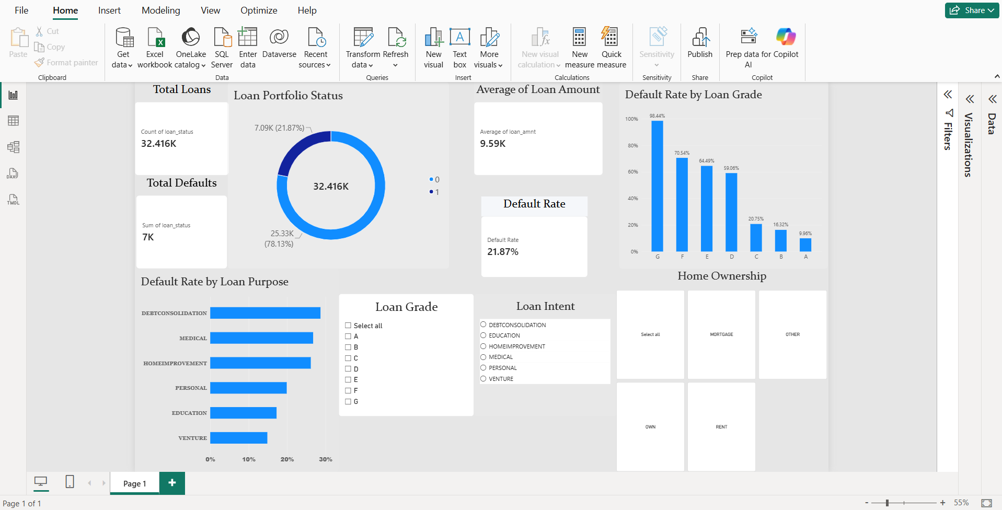
Power BI Dashboard
1 Executive Risk Overview

Slide 6
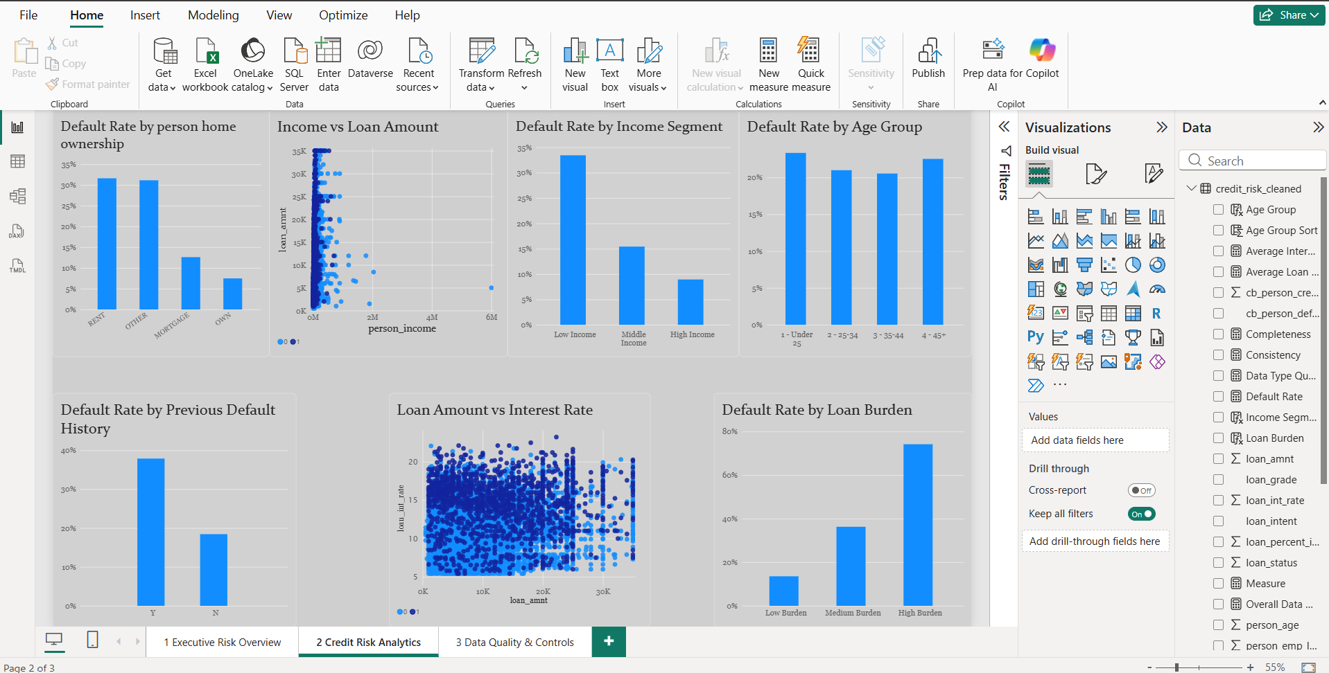
Power BI Dashboard
2 Credit Risk Analysis

Slide 7
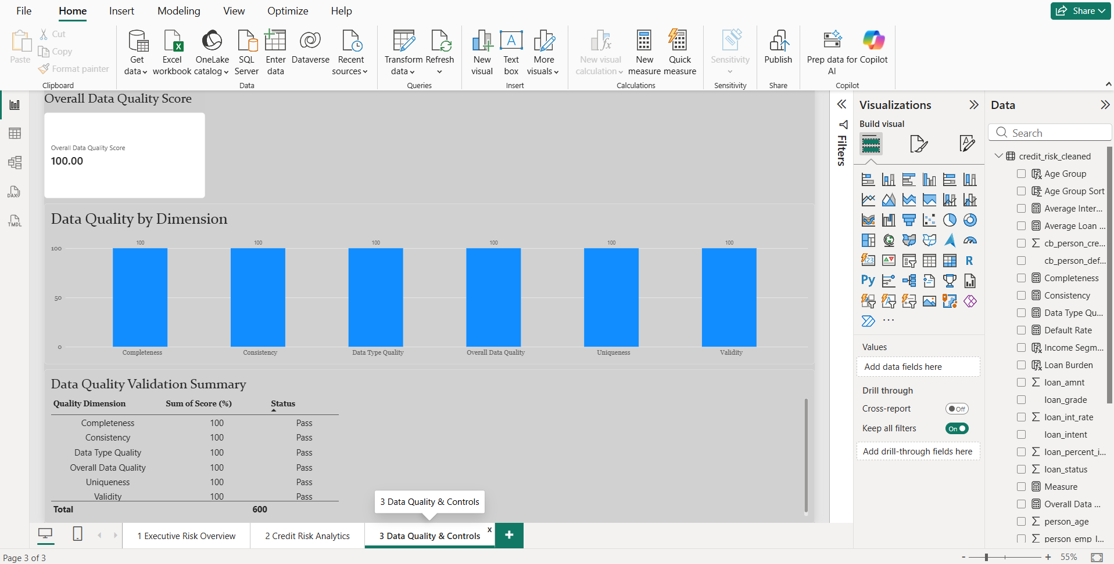
Power BI Dashboard
3 Data Quality and Control

Slide 8
Key Insights & Project Outcomes
Key Insights
Default rates vary across loan grades and borrower segments.
Loan burden provides an important indicator for risk segmentation.
Previous default history is a relevant risk signal in the analysis.
Extreme-value screening identified potential anomalies for further investigation.
Data-quality validation provides an additional layer of control before reporting.
Project Outcomes
End-to-end credit risk analytics workflow
Python-based data cleaning and EDA
SQL-based analytical queries
Data-quality assessment framework
Logistic Regression and Random Forest models
Model evaluation and explainability
3-page interactive Power BI dashboard
Reproducible project structure with GitHub documentation
Conclusion
The project transforms raw credit data into validated analytical outputs and interactive risk insights by integrating
Python, SQL, Machine Learning, Power BI and data-quality controls.

